Slide 1
Goldman Sachs
David M Solomon
Managing Director
(Office of Chairman Dept)
John E Waldron
Managing Director
(Office of Chairman Dept)
Organization chart
Stephanie E Cohen
Managing Director
(PS Leadership (Private))
Offshore
On Site
Ilya Gayinskiy
Managing Director
(EP Eng Mgmt $& Strategy)
James Rinsler
Managing Director
(EP Eng Cards)
Thota M Mohan
Vice President
(EP Eng Cards)
Jaswant Ganapa
Vice President
(EP Eng Cards)
Sowmya Bejjipuram
Vice President
(EP Eng Cards)
Pranob s Samani
Vice President
(EP Eng Cards)
Srinidhi Sridharan
Vice President
(EP Eng Cards)
Akshay Talathi
Vice President
(EP Eng Cards)
Ashok Kumar
Contingent Worker
(EP Eng Cards)
Manoj Bisht
Contingent Worker
(EP Eng Cards)
Bhaskar Tomar
Contingent Worker
(EP Eng Cards)
Amod Mahajan
Contingent Worker
(EP Eng Cards)

Slide 2
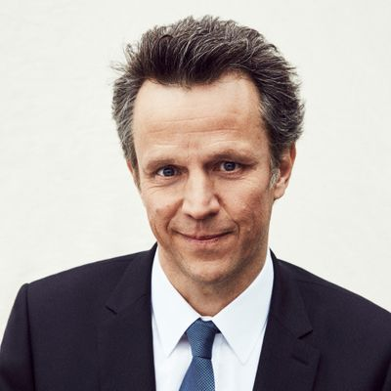
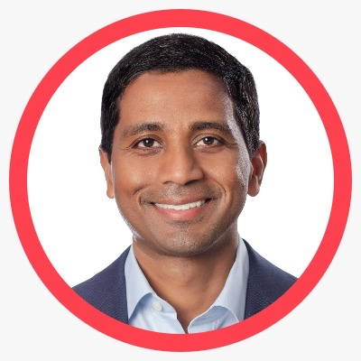
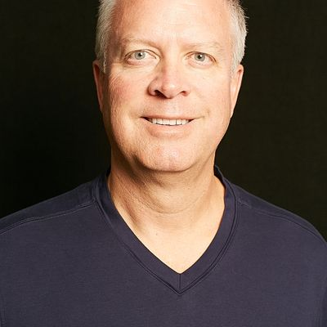

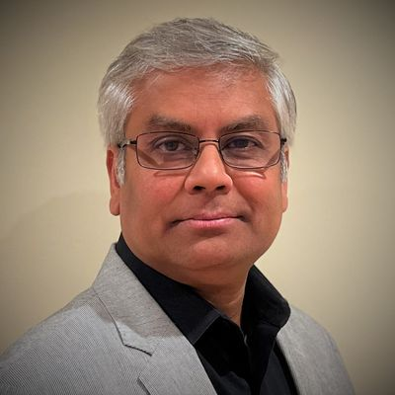


Publicis Sapient
Arthur Sadoun
President
Organization chart
Nigel Vaz
CEO
Offshore
On Site
Robert Van Beber
Chief Delivery Officer
Tilak Doddapaneni
Executive Vice President
Chirag Shah
Senior Vice President
Omkar Shukla
Senior Director Engineering
Barun Kumar Yadav
Senior Manager Technology

Slide 3
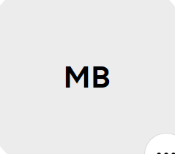
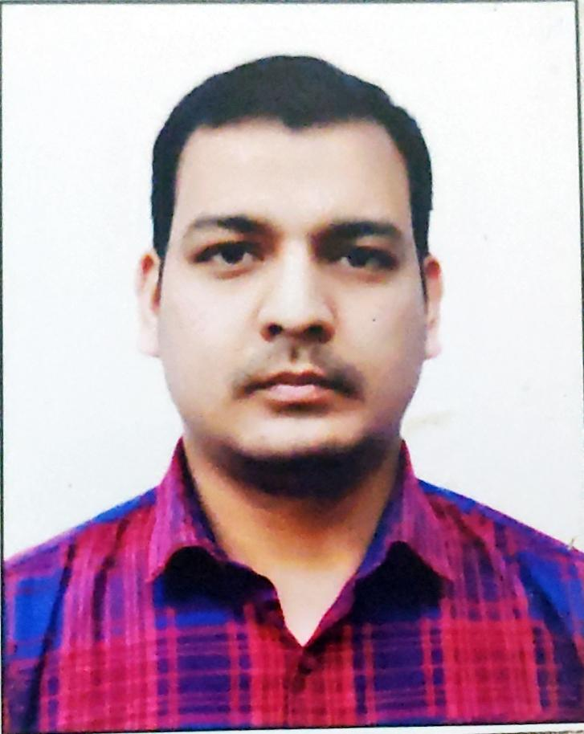
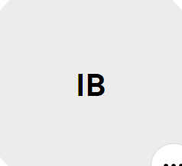

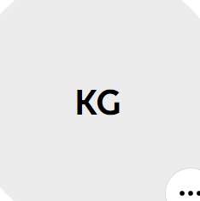

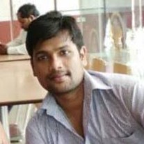
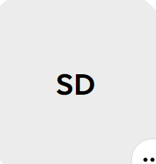

Publicis Sapient
Organization chart continue
Offshore
On Site
Manjul Bhakri
Specialist Plateform
Manoj Bisht
SAT L1
Indranil Banerjeee
SAP L1
Deepak Kumar
AT L2
Kartik Gupta
SAP L1
Antoni Rempala
ASDE 1
Rohit Nagappa
SAT L2
Shruti Dhiman
AT L2
Manik Kumar
SAT L1

